Slide 1
UCS1502 - MICROPROCESSORS AND INTERFACING
Interrupt Programming
S. Angel Deborah
Assistant Professor, Dept. of CSE

Slide 2
Learning Objective
To understand interrupts in 8051
To understand interrupt programming in 8051

Slide 3
Overview

Slide 4
Interrupt Vs Polling
An interrupt is an external or internal event that interrupts the microcontroller to inform it that a device needs its service
A single microcontroller can serve several devices by two ways
  Interrupts
    Whenever any device needs its service, the device notifies the microcontroller by sending it an interrupt signal
    Upon receiving an interrupt signal, the microcontroller interrupts whatever it is doing and serves the device
    The program which is associated with the interrupt is called the interrupt service routine (ISR) or interrupt handler
  Polling
    The microcontroller continuously monitors the status of a given device
    When the conditions met, it performs the service
    After that, it moves on to monitor the next device until every one is serviced

Slide 5
Interrupt Vs Polling
Polling can monitor the status of several devices and serve each of them as certain conditions are met
The polling method is not efficient, since it wastes much of the microcontroller’s time by polling devices that do not need service
Ex: JNB TF, target
The advantage of interrupts is that the microcontroller can serve many devices (not all at the same time)
  Each devices can get the attention of the microcontroller based on the assigned priority
  For the polling method, it is not possible to assign priority since it checks all devices in a round-robin fashion
The microcontroller can also ignore (mask) a device request for service
  This is not possible for the polling method

Slide 6
Interrupt Service Routine
For every interrupt, there must be an interrupt service routine (ISR), or interrupt handler
  When an interrupt is invoked, the microcontroller runs the interrupt service routine
  For every interrupt, there is a fixed location in memory that holds the address of its ISR
  The group of memory locations set aside to hold the addresses of ISRs is called interrupt vector table

Slide 7
Steps in Executing an Interrupt
Upon activation of an interrupt, the microcontroller goes through the following steps
  It finishes the instruction it is executing and saves the address of the next instruction (PC) on the stack
  It also saves the current status of all the interrupts internally (i.e: not on the stack)
  It jumps to a fixed location in memory, called the interrupt vector table, that holds the address of the ISR

Slide 8
Steps in Executing an Interrupt
The microcontroller gets the address of the ISR from the interrupt vector table and jumps to it
  It starts to execute the interrupt service subroutine until it reaches the last instruction of the subroutine which is RETI (return from interrupt)
Upon executing the RETI instruction, the microcontroller returns to the place where it was interrupted
  First, it gets the program counter (PC) address from the stack by popping the top two bytes of the stack into the PC
  Then it starts to execute from that address

Slide 9
Six Interrupts in 8051
Six interrupts are allocated as follows
  Reset – power-up reset
  Two interrupts are set aside for the timers: one for timer 0 and one for timer 1
  Two interrupts are set aside for hardware external interrupts
    P3.2 and P3.3 are for the external hardware interrupts INT0 (or EX1), and INT1 (or EX2)
  Serial communication has a single interrupt that belongs to both receive and transfer

Slide 10
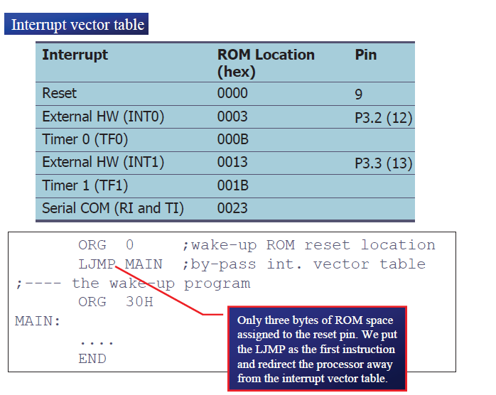
Six Interrupts in 8051

Slide 11
Enabling and Disabling an Interrupt
Upon reset, all interrupts are disabled (masked), meaning that none will be responded to by the microcontroller if they are activated
The interrupts must be enabled by software in order for the microcontroller to respond to them
  There is a register called IE (interrupt enable) that is responsible for enabling (unmasking) and disabling (masking) the interrupts
To enable an interrupt, we take the following steps:
  Bit D7 of the IE register (EA) must be set to high to allow the rest of register to take effect
  The value of EA
    If EA = 1, interrupts are enabled and will be responded to if their corresponding bits in IE are high
    If EA = 0, no interrupt will be responded to, even if the associated bit in the IE register is high

Slide 12
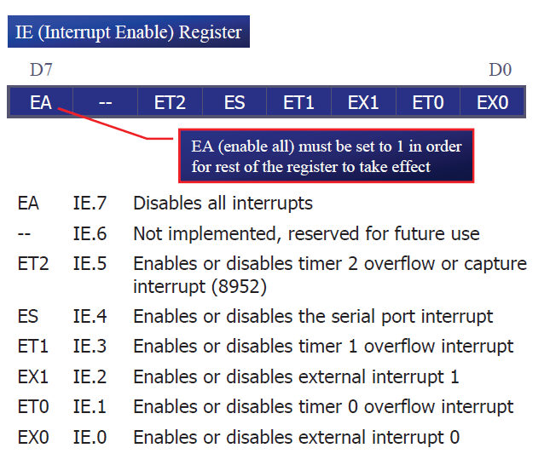
Enabling and Disabling an Interrupt

Slide 13
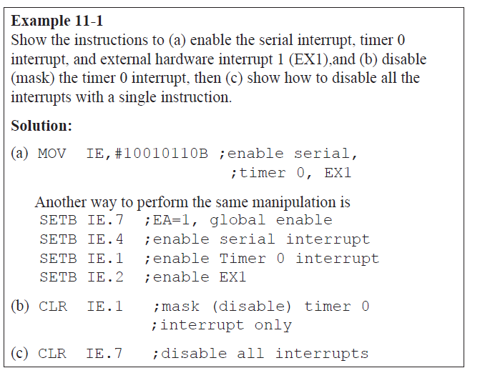
Enabling and Disabling an Interrupt

Slide 14

Timer Interrupts
The timer flag (TF) is raised when the timer rolls over
  In polling TF, we have to wait until the TF is raised
    The problem with this method is that the microcontroller is tied down while waiting for TF to be raised, and can not do anything else
  Using interrupts solves this problem and, avoids tying down the controller
    If the timer interrupt in the IE register is enabled, whenever the timer rolls over, TF is raised, and the microcontroller is interrupted in whatever it is doing, and jumps to the interrupt vector table to service the ISR
    In this way, the microcontroller can do other until it is notified that the timer has rolled over

Slide 15
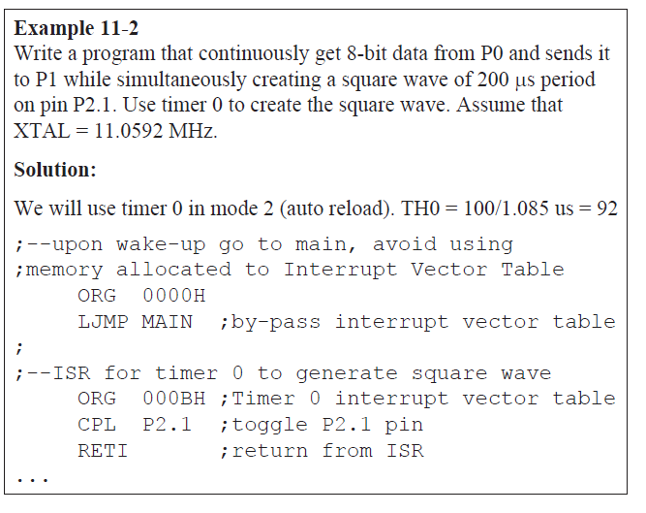
Timer
Interrupts

Slide 16
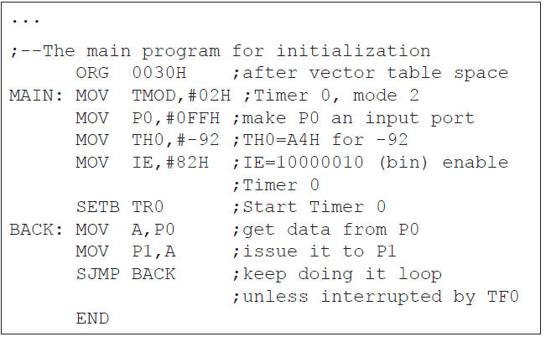
Timer
Interrupts

Slide 17
External hardware interrupts
The 8051 has two external hardware interrupts
  Pin 12 (P3.2) and pin 13 (P3.3) of the 8051, designated as INT0 and INT1, are used as external hardware interrupts
    The interrupt vector table locations 0003H and 0013H are set aside for INT0 and INT1
  There are two activation levels for the external hardware interrupts
    Level trigged
    Edge trigged

Slide 18
Summary
8051 Features
Block Diagram of 8051
8051 Oscillator and Clock
Program counter and Data Pointer
Flags and Program Status Word [PSW]

Slide 19
Check your understanding
How does 8051 differ from 8086?

Slide 20
Reference
Mohamed Ali Mazidi, Janice Gillispie Mazidi, Rolin McKinlay, “The 8051Microcontroller and Embedded Systems: Using Assembly and C”, 2nd Edition,Pearson education, 2011.

Slide 21
Thank you

